Slide 1
Scientific Visualization
User Lab Day 2018
Jean M. Favre, CSCS
September 11th 2018
Notes:
<number>

Slide 2
Outline
Recommendations about which file formats to use for 3D visualization
Overview of the three most important Scientific Visualization Applications
ParaView
VisIt
VMD
Usage scenarios
Desktop usage
Client-server
Batch-mode, server-side execution
Listening to your wishes

Slide 3
Scientific Visualization and I/O libraries
The two topics are closely linked.
Samuel Omlin has introduced the topic of parallel I/O
I will follow with issues related to Scientific Visualization

Slide 4
Custom file formats for Visualization?
Whenever possible, we recommend to not use custom file formats
Why so?
It takes a considerable effort to make plugins for Visualization Applications
Portability across platforms would be an issue
Making the I/O parallel is non-trivial
You will most-often have to compile from source

Slide 5
Standard file formats
Our three Scientific Visualization applications, ParaView, VisIt and VMD support several hundreds of file formats.
Use any one of the adopted file formats:
Our task is to always have the most recent versions of the apps, finely-tuned for Piz Daint so that you can view the I/O problem as „Problem solved“
The community is large. Bug reports and bug fixes are common.
The web is full of resources, mailing lists, forums, etc.
Our task is to guide you to select the best file formats for writing and reading your simulation data.

Slide 6
Libraries and Conventions
Beware of the difference between using a library, and using an adopted convention.
Said in other words: „Simply using HDF5 or NetCDF does not guarantee the Viz Applications will be able to read the data out-of-the-box“
Conventions, such as the CF convention for Climate Data would be the right choice.
Using XDMF to give the semantics of the data organization is one way to get access to HDF5 data
In both of these cases, we are here to help you and guide you in making the right decisions.

Slide 7
Overview of three Scientific Visualization Applications

Slide 8
ParaView and VisIt
Similar paradigms of use:
Desktop, client-server (parallel) and batch-only(parallel) execution
Python-driven
Many supported file formats in common
Documentation:
https://user.cscs.ch/computing/visualisation/paraview/ Gallery
https://user.cscs.ch/computing/visualisation/visit/ Gallery

Slide 9
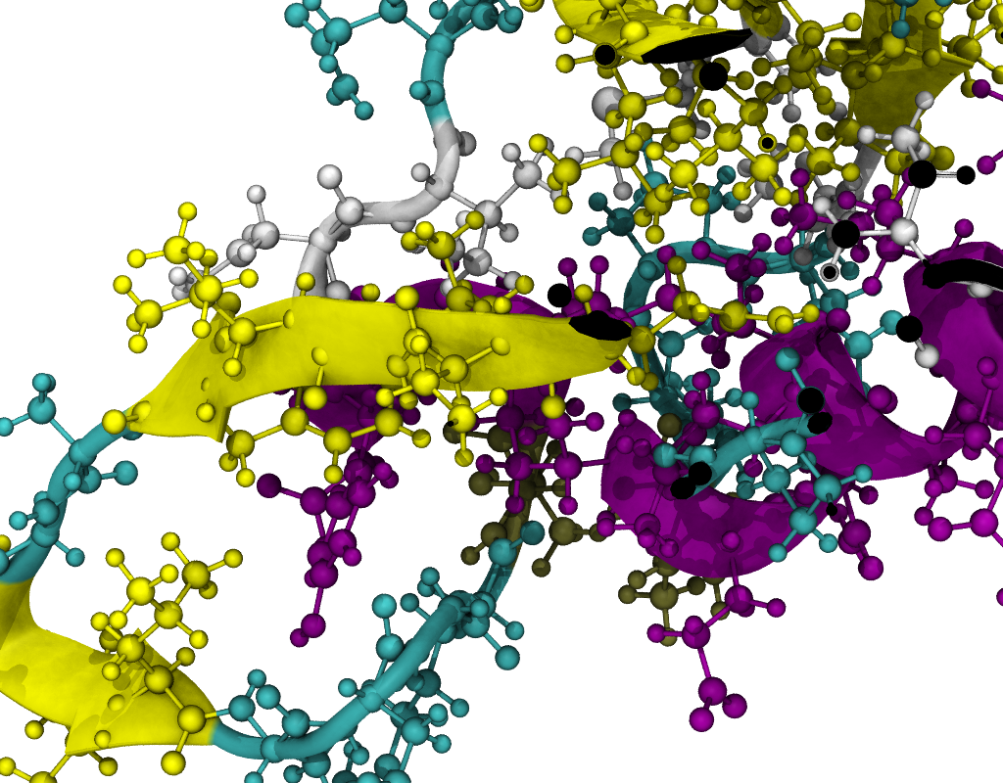
VMD
Users of CP2K, Quantum Espresso, LAMMPS, GROMACS, VASP, NAMD, NWChem, Amber, can take advantage of an optimized installation of VMD on daint.
Runs on compute nodes with GPU acceleration, in batch mode, or inside a remote VNC desktop.
https://user.cscs.ch/computing/visualisation/vmd/

Slide 10
Scenarios of usage
We advocate the use of python scripts for all visualization activities, for desktop or parallel client-server runs
Reproducibility
Sharing – re-using
Automation
Fine-tuning for more effective resource allocation
Many modules:
import numpy as np …… and more

Slide 11
Python-driven scripting for ParaView and VisIt
The applications can save their state in Python.
It covers 100% of the normal usage
It covers 80-90% of the advanced usage
Our contribution is often to augment python scripts with missing functionality.

Slide 12
New: ParaView for the multi-core partition!
Huge improvements have been made for software rendering using Mesa
LLVM
“The LLVM Core libraries provide a modern source- and target-independent optimizer, along with code generation support for many popular CPUs”
We compile Mesa with an LLVM backend for multi-core support and to fully utilize the modern instruction sets of Intel® SSE4, AVX, AVX2

Slide 13
Headless rendering, GPU-accelerated or LLVM-OSMesa rendering
Definitions to help your understanding:
Headless rendering
On the server side, ParaView does not need to open a graphics window to do its rendering. No need for an X-server running on the compute nodes
GPU-accelerated rendering
OpenGL on NVIDIA hardware with EGL
OSMesa rendering
off-screen Mesa on the multi-core CPU

Slide 14
Resource allocation will differ
With GPU
#SBATCH –constraint=gpu
module load ParaView/5.5.2-CrayGNU-18.08-EGL
Without GPU
#SBTACH –constraint=mc
#SBATCH --cpus-per-task=72
#SBATCH --ntasks-per-core=2
# Can use high-memory nodes
#SBATCH –mem=122G
module load ParaView/5.5.2-CrayGNU-18.08-OSMesa

Slide 15
Resource allocation is automatic if using the documented procedures
With VisIt
Choose host=daint to connect to the login node
Select a file to open
Choose the allocation needed
The VisIt server process creates an executable submitted to srun
Connection takes place and more files can be opened with the existing session.
With ParaView
First, Open a connection with a resource allocation request
Connection takes place when resource is allocated
One or more files can be opened

Slide 16
Remote connection with python clients (VisIt)
With VisIt
from visit import *
Launch()
args = ("-sshtunneling", "-np", "24", "-nn", "1", "-l", "srun", "-dir", "/apps/daint/UES/jenkins/6.0.UP04/mc/easybuild/software/Visit/2.13.0-CrayGNU-17.08", "-t", "00:05:00", "-la", "--cpu_bind=sockets -C mc -p debug")
host = "daint101.login.cscs.ch"
OpenComputeEngine(host, args)
OpenGUI()

Slide 17
Remote connection with python clients (ParaView)
First Step, put the client in waiting mode
from paraview.simple import *
ReverseConnect(“1100”)
>>> Connection (csrc://hostname:1100)
(use your own id instead of, my private id (1100)
Second Step, execute the remote script creating the SLURM job
ssh -l jfavre -R 1100:localhost:1100 daint103.login.cscs.ch "/apps/daint/UES/ParaView/rc-submit-pvserver.sh pvserver 00:19:59 1 3 1100 daint103.login.cscs.ch GNU-5.5 debug; sleep 180"

Slide 18
Remote connection with python clients (ParaView)
Temporary FileName is : /tmp/tmp.ZqTUSq2MsD
#!/bin/bash
#SBATCH --job-name=pvserver
#SBATCH --nodes=1
#SBATCH --ntasks-per-node=3
#SBATCH --ntasks=3
#SBATCH --time=00:19:59
#SBATCH --partition=debug
#SBATCH --constraint=gpu
module load daint-gpu
module load ParaView/5.5.1-CrayGNU-17.08-EGL
srun -n 3 -N 1 --cpu_bind=sockets pvserver -rc
-ch=daint103.login.cscs.ch -sp=1100
Submitted batch job 9565038
Testing from your client:
Sphere()
pid = ProcessIdScalars()
Show()
Render()

Slide 19
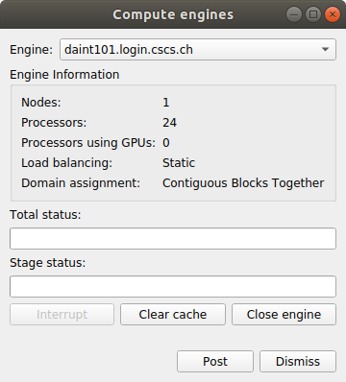
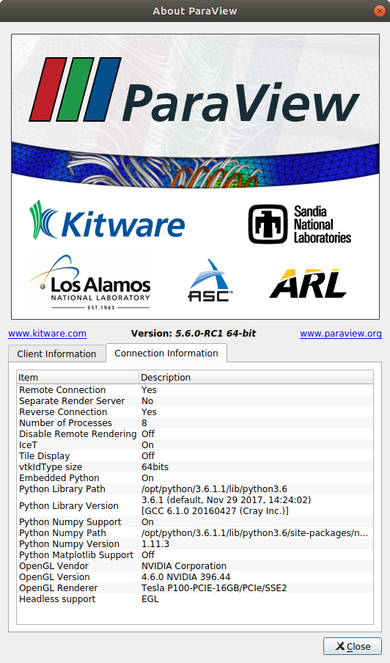
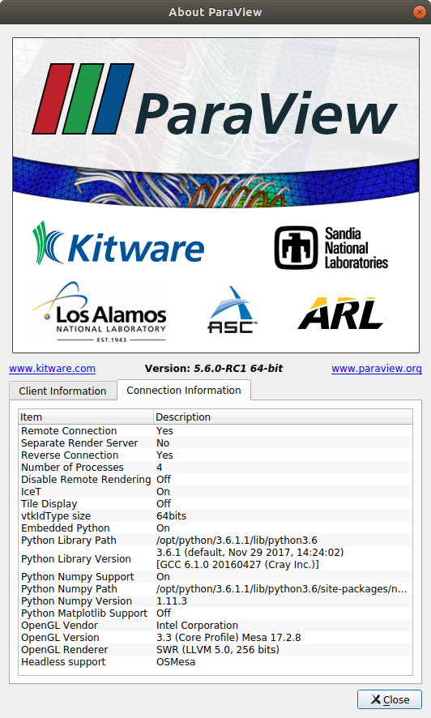
Once connected to a remote session...
With VisIt
With ParaView

Slide 20
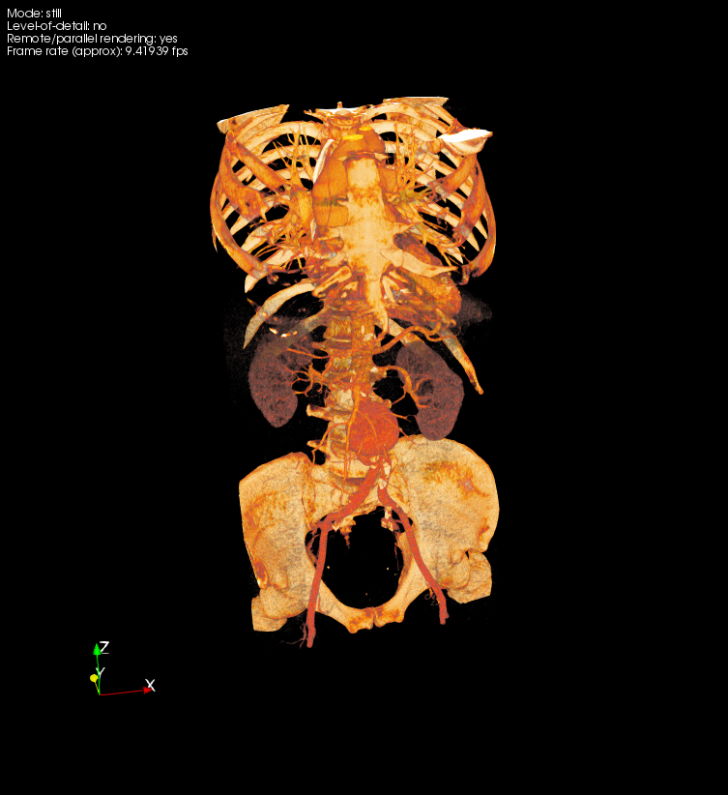
Motivational Examples
From raw data to interactive visualization
Simply loading the raw data results in in an image with little appeal.

Slide 21
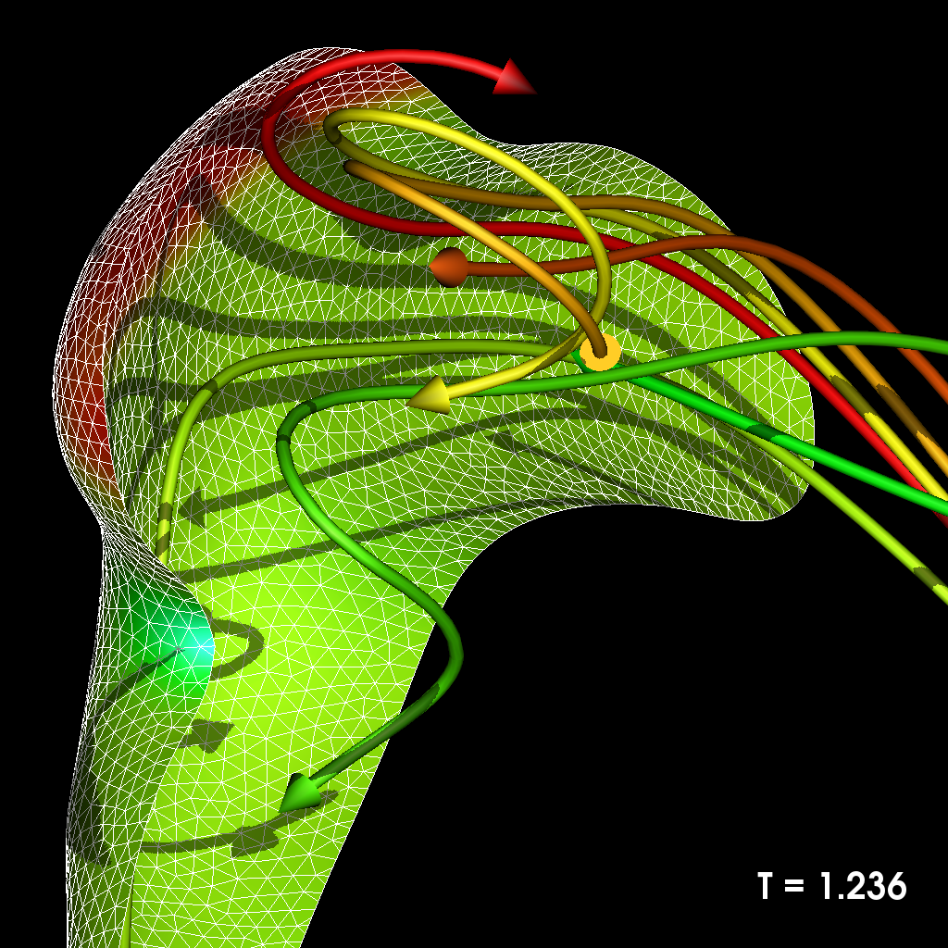
Motivational Examples
Increased perception with tricks and advanced rendering

Slide 22
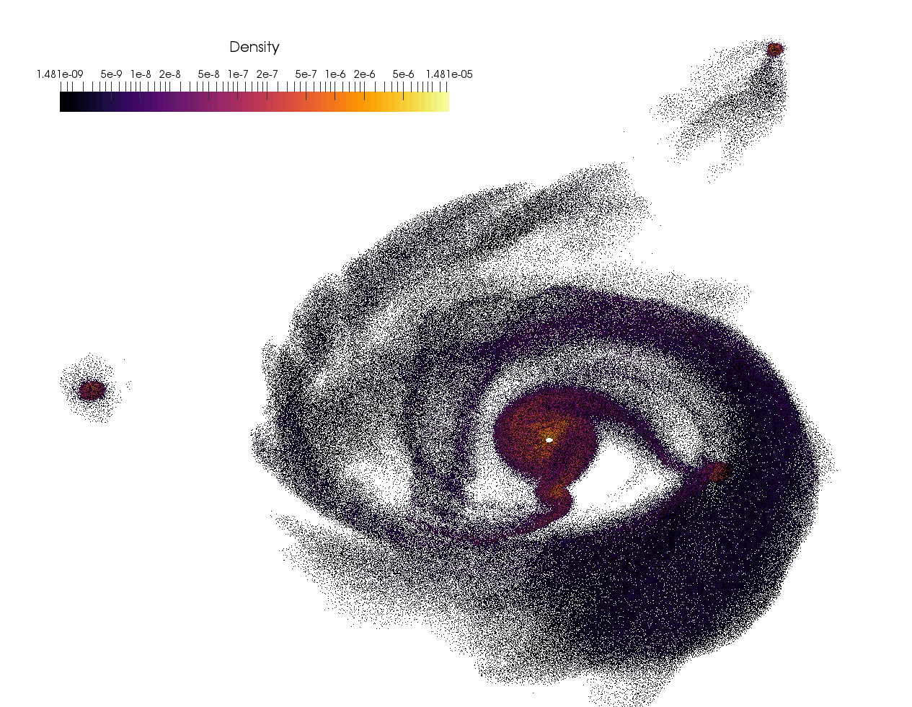
Motivational Examples
Benchmarking of Point Cloud Processing and Rendering

Slide 23
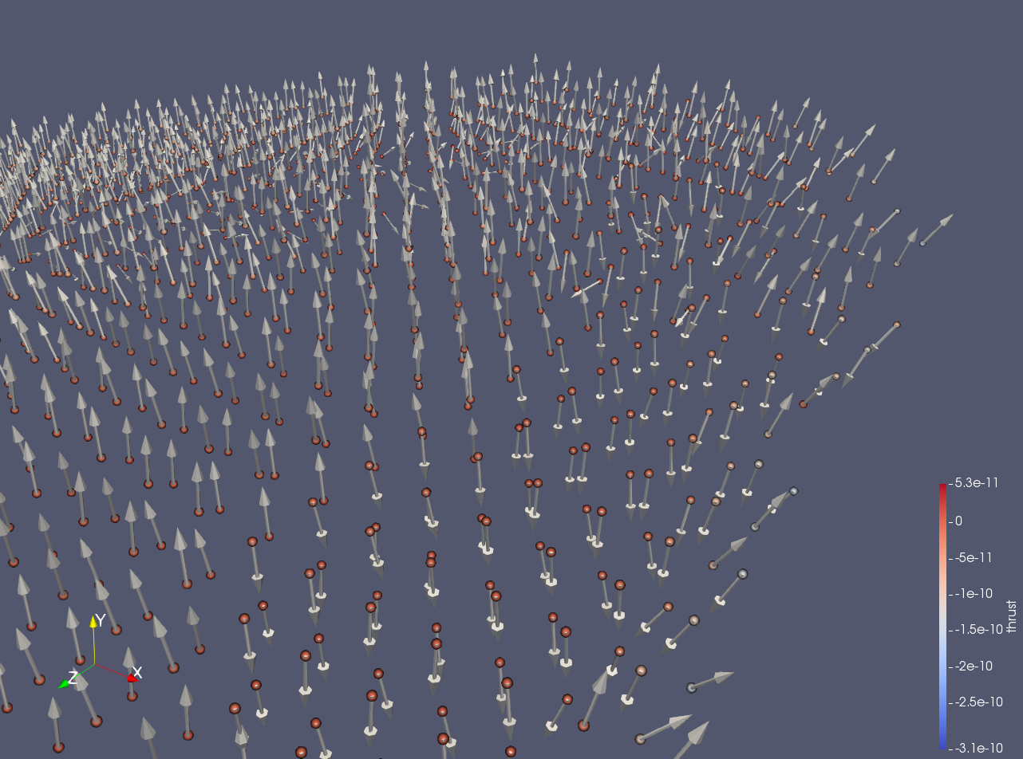
Motivational Examples
Visualization as a debugging tool
A process that has lasted several months during multiple versions of the code development

Slide 24
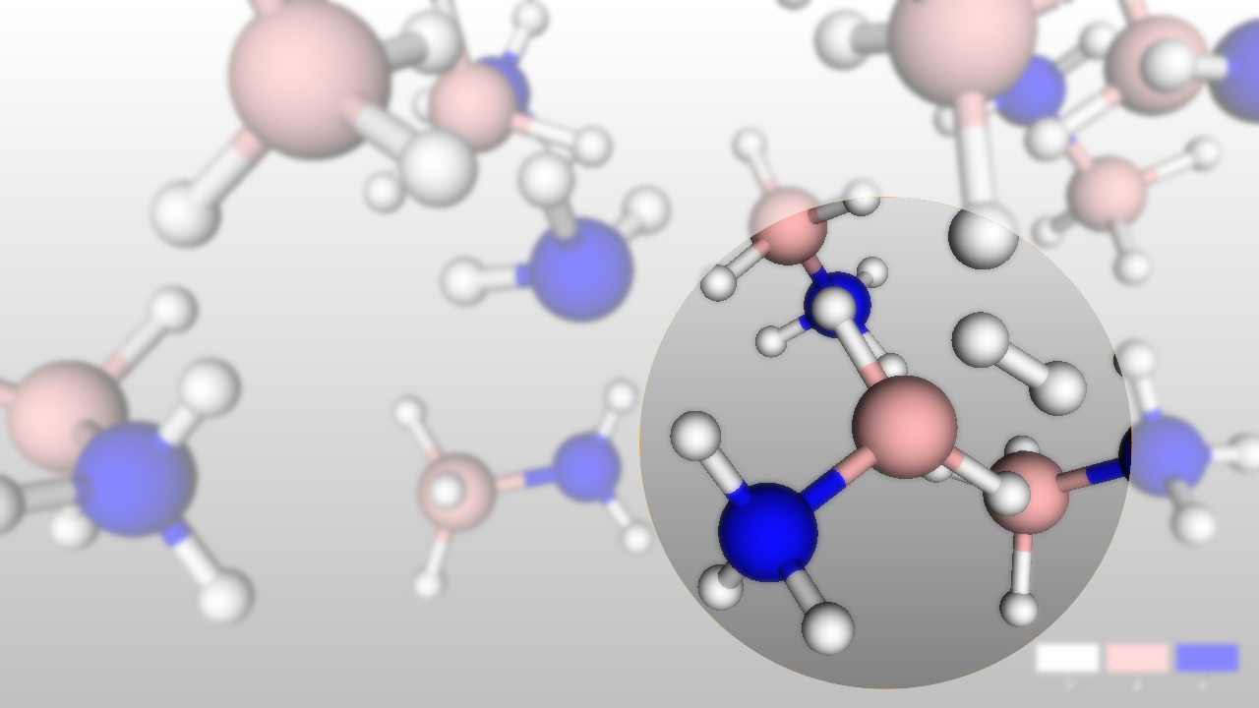
Motivational Examples
Very simple, small dataset
Very confusing to see in 3D
Enhancing the traditional displays…
Work in progress...

Slide 25
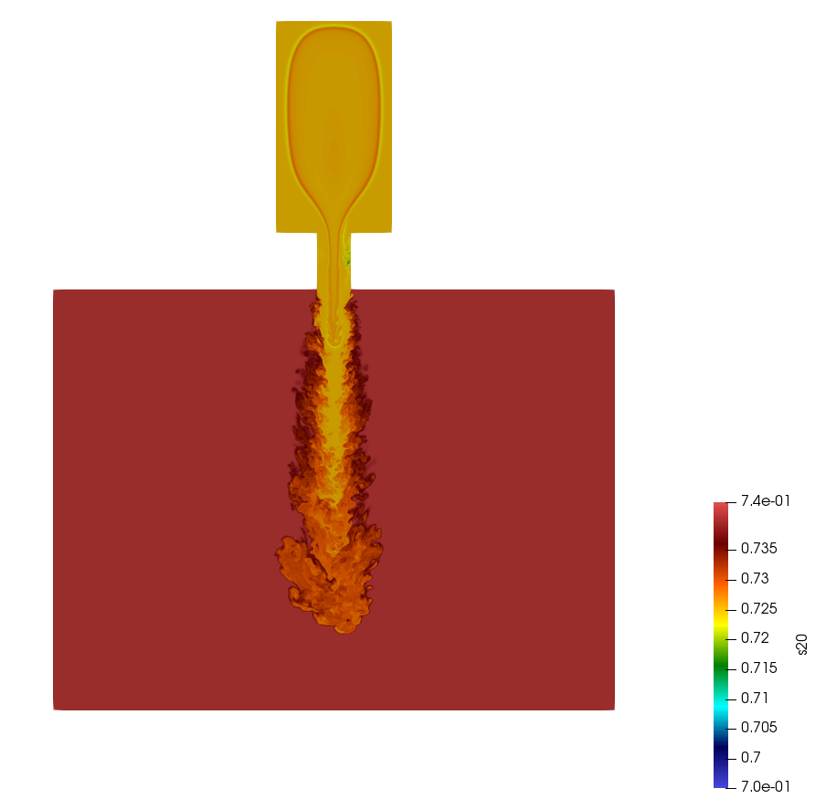
Motivational Examples
A bug in the viz application was only discovered when testing with Very large data (near a billion cell)
We found the bug, developed a patch, installed the patch on Piz Daint, contributed the patch to the open-source dev tree

Slide 26
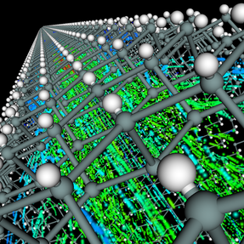
Motivational Examples
Mixing molecular rendering with traditional structured grid rendering called for a custom viz mini-app

Slide 27
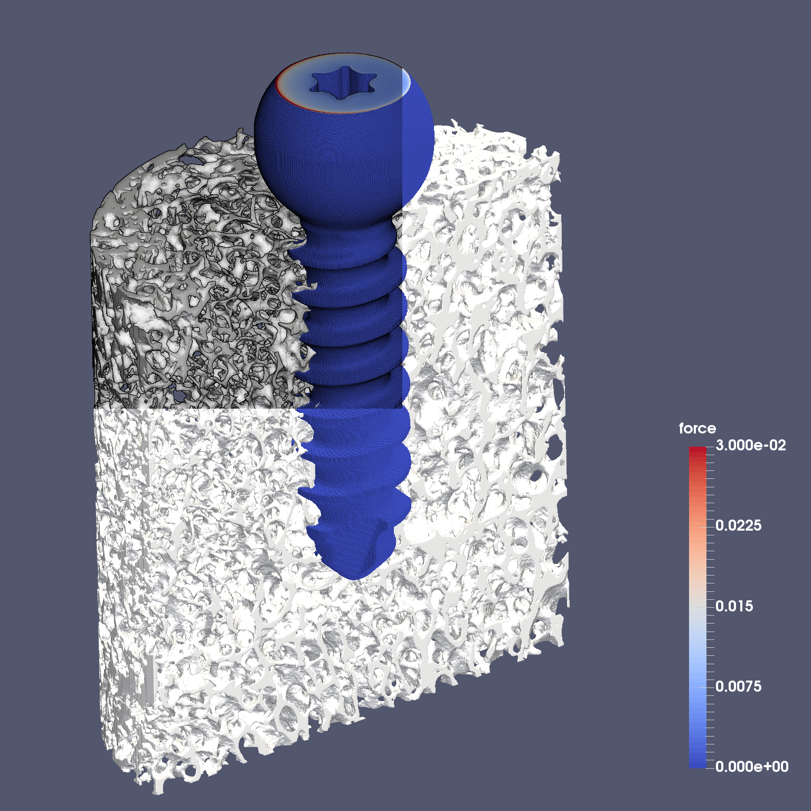
Motivational Examples
Enhancing 3D perception...

Slide 28
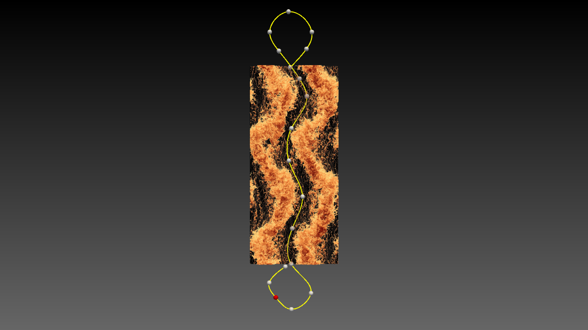
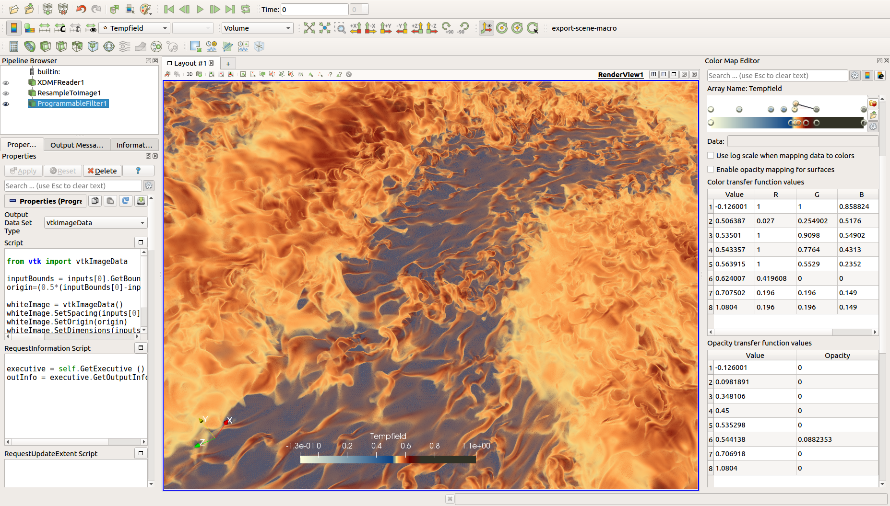
Motivational Examples

Slide 29
Soon available on Piz Daint
ParaView v5.5 with OSMesa for the MC partition
ParaView v5.6 for the GPU and MC partitions

Slide 30
Summary
A great deal of experience has been collected on advanced and efficient use of data (file) storage to enable, and accelerate I/O for Visualization
Likewise, daily practice with a few Visualization applications gives us an added advantage
Advanced scripting knowledge is available to make the best of the tools
Nearly fully-automatized client-server connections to viz tools (ParaView and VisIt) are offered as a service
Consult with us
We are here to assist you.
vis-rt@cscs.ch

